Slide 1

Machine Learning Modeling
Bicycle Theft Dataset
Xiaojing Xu 300993994
Arshdeep Kaur 301025322
Jashanjot Singh 301050281
Shane Chandon 300523848
Dec 1st , 2020

Slide 2
1
Introduction
Agenda
2
Data Analysis
Structure & Data Wrangling & Diagrams
3
Predictive Data Model - Logistic Regression
Model Logic & Evaluation
4
Predictive Data Model - Decision Tree
Model Logic & Evaluation
5
Deployment
API App Testing

Slide 3

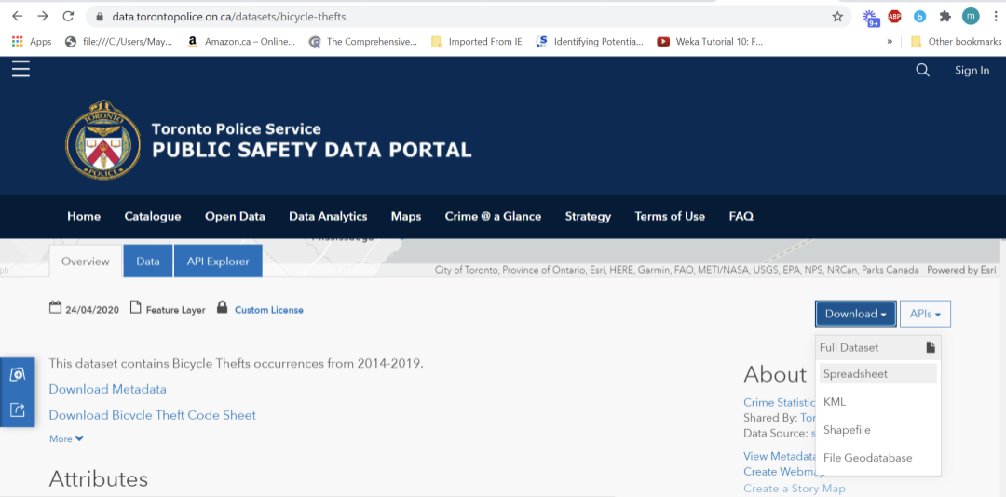
01
Introduction
Our Target: Help to analyse the data and make a prediction based on a reasonable model by machine learning

Slide 4

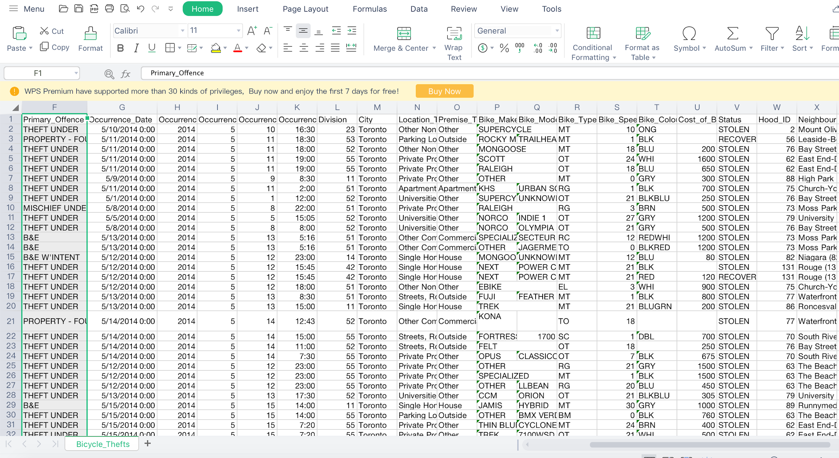
02
Data Analysis

Slide 5
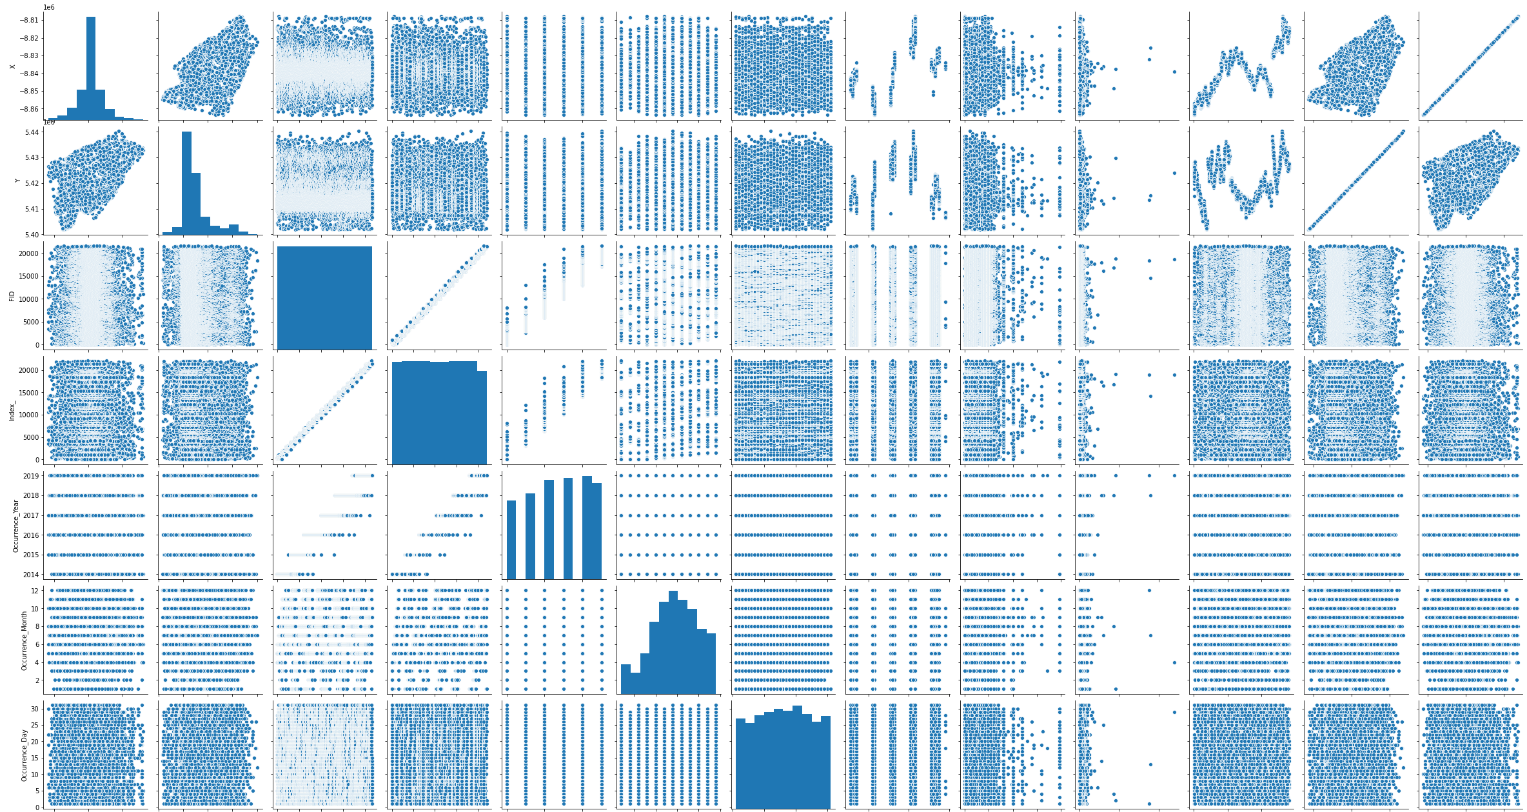
02
Data Analysis

Slide 6
02
Data Analysis

Slide 7
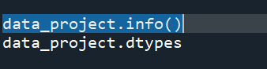
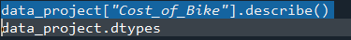
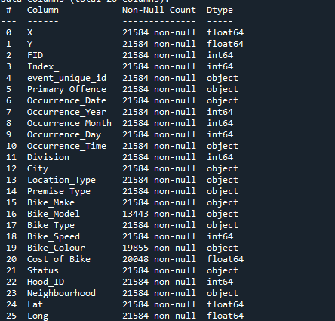
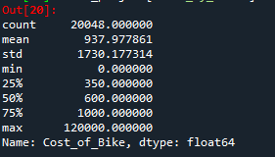
02
Data Analysis

Slide 8
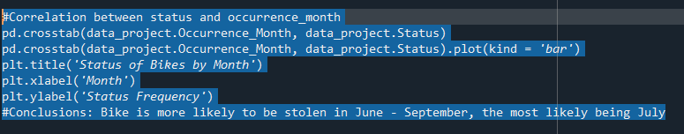
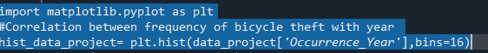
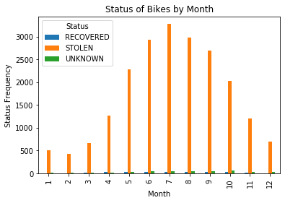
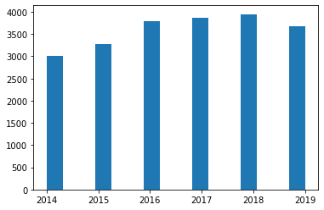
02
Data Analysis

Slide 9
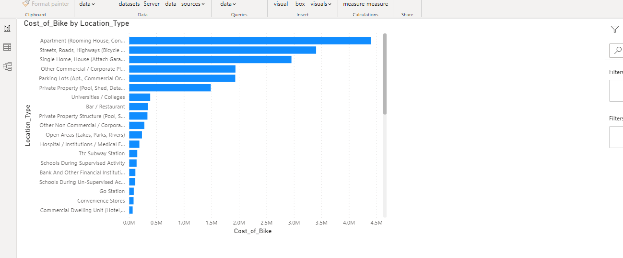
02
Data Analysis
From here we can analyze that most of costly bikes are in apartment Type
Created using PowerBI

Slide 10
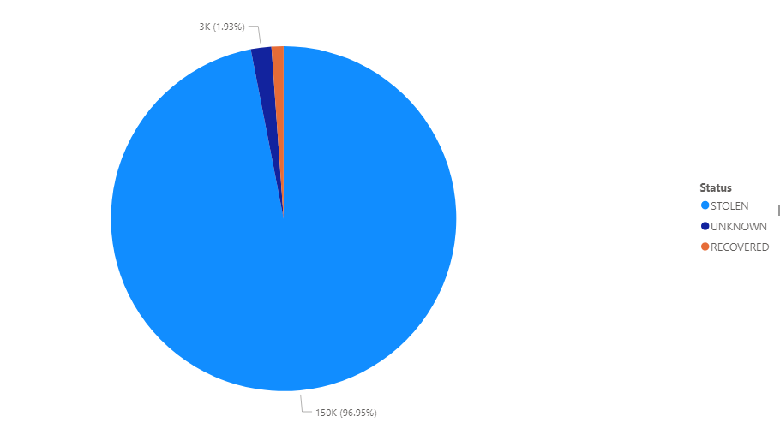
02
Data Analysis
From here we can analyze that most of bikes are stolen followed by unknown and recovered.
Created using PowerBI

Slide 11
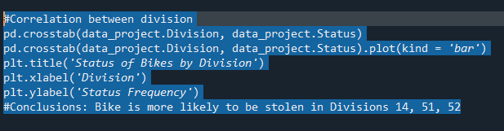
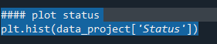
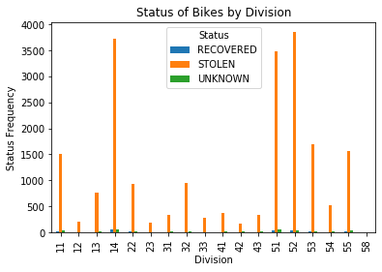
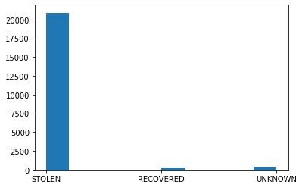
02
Data Analysis

Slide 12
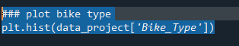
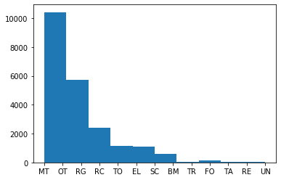
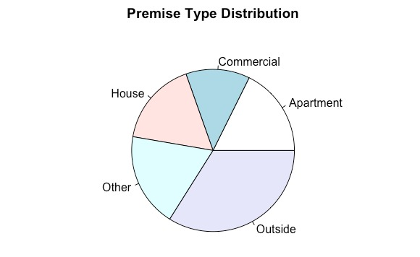
02
Data Analysis

Slide 13
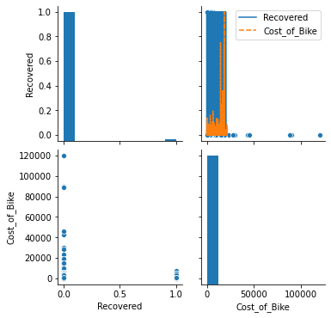
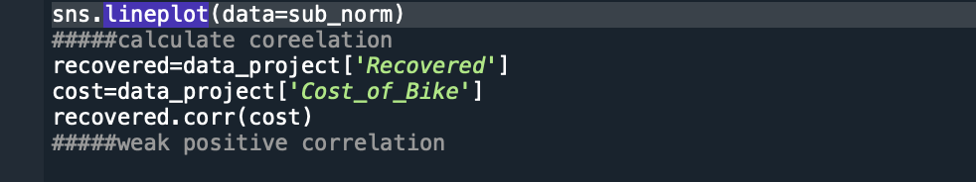
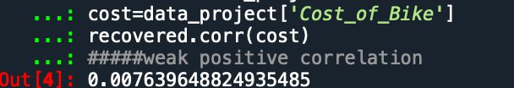
02
Data Analysis

Slide 14
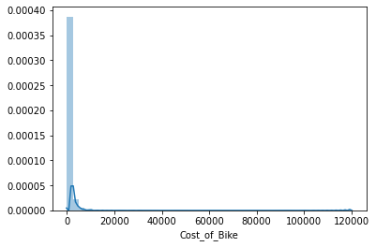
02
Data Analysis

Slide 15
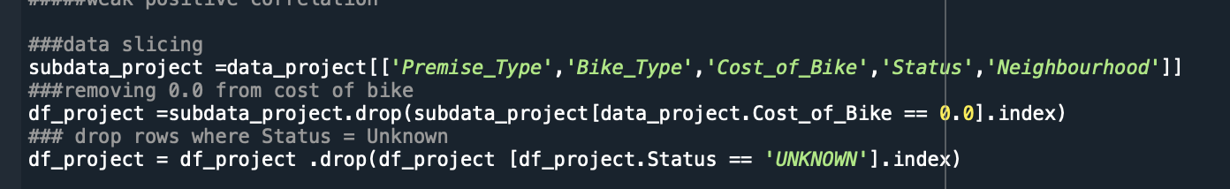
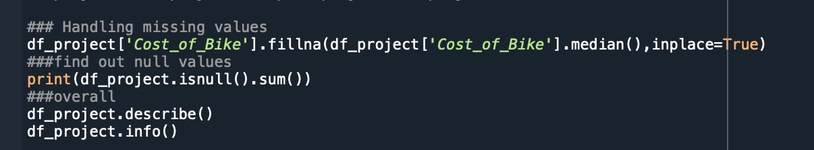
02
Data Wrangling

Slide 16
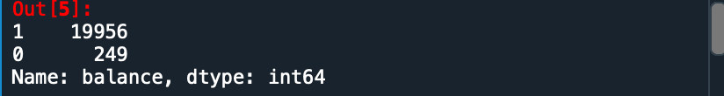
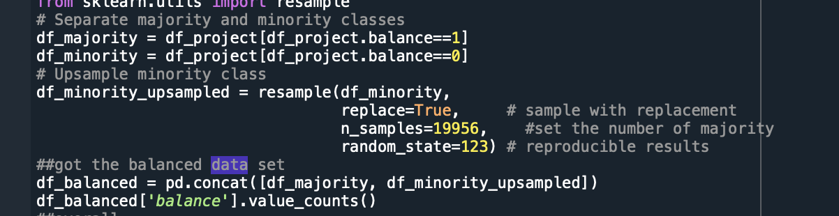
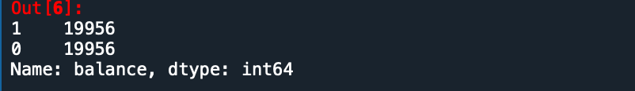
02
Data Wrangling

Slide 17
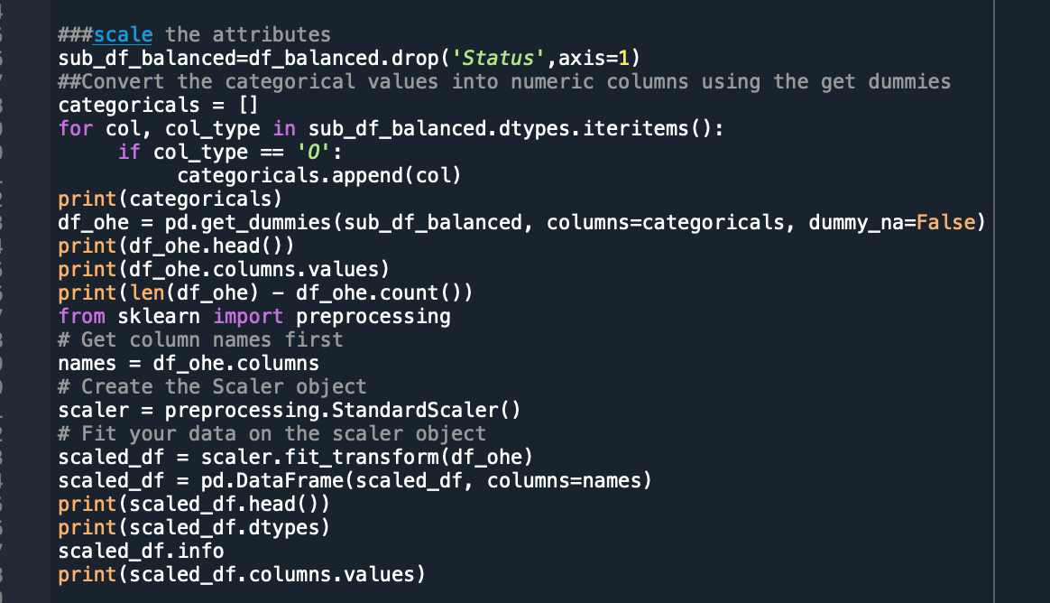
02
Data Wrangling

Slide 18
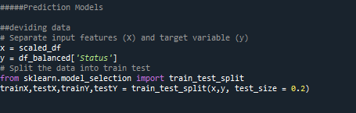
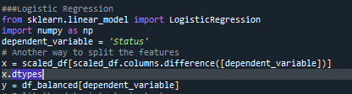
03
Logistic Regression
The First prediction model: Logistic Regression

Slide 19
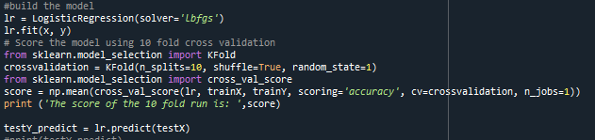
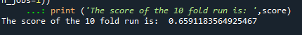
03
Logistic Regression
Build the Model

Slide 20
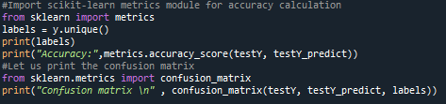
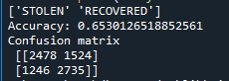
03
Logistic Regression
Testing
True Predictions: 5213
False Predictions: 2773

Slide 21
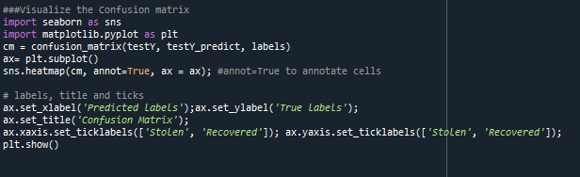
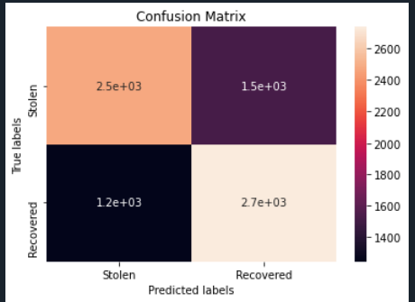
03
Logistic Regression
Testing

Slide 22
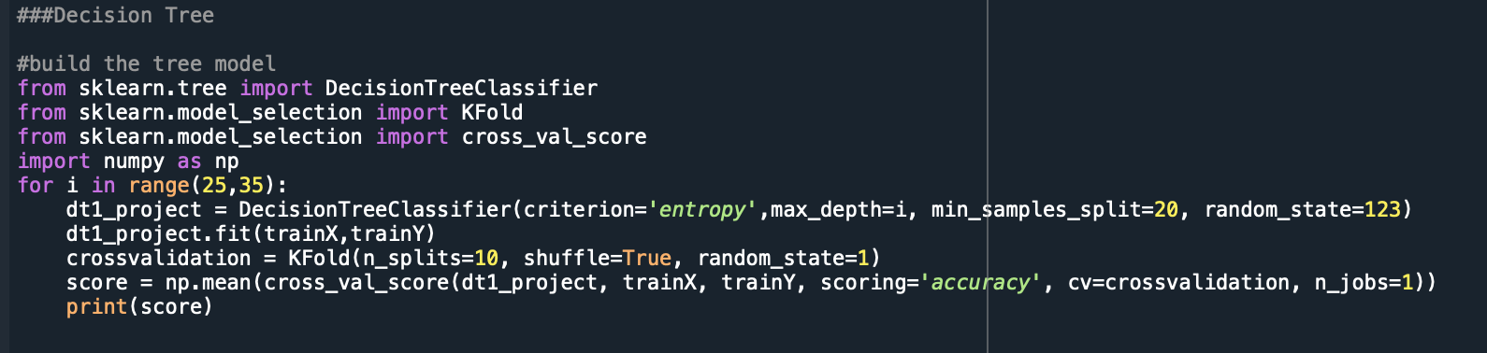
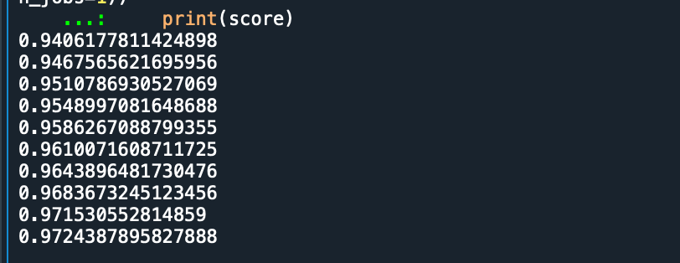
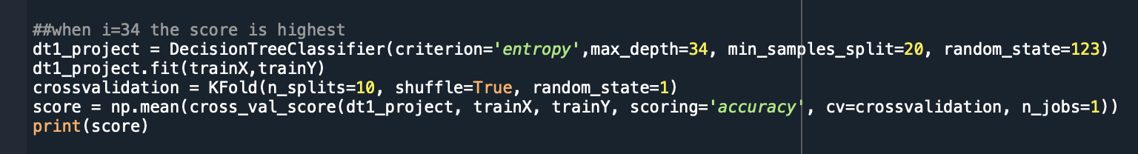
04
Decision Tree
The Second prediction model: Decision Tree
Build the Model

Slide 23
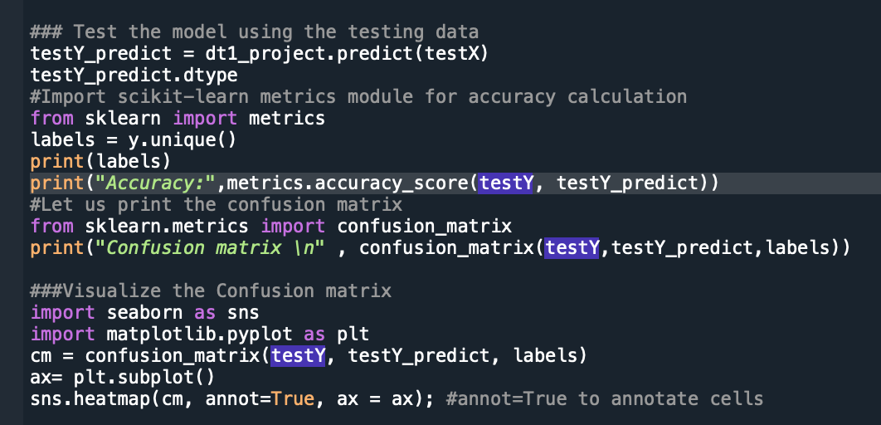
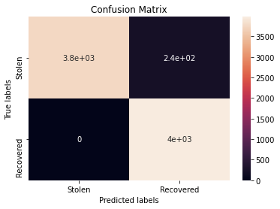
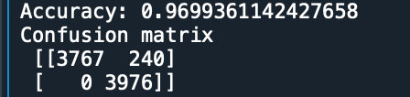
04
Decision Tree
Testing

Slide 24
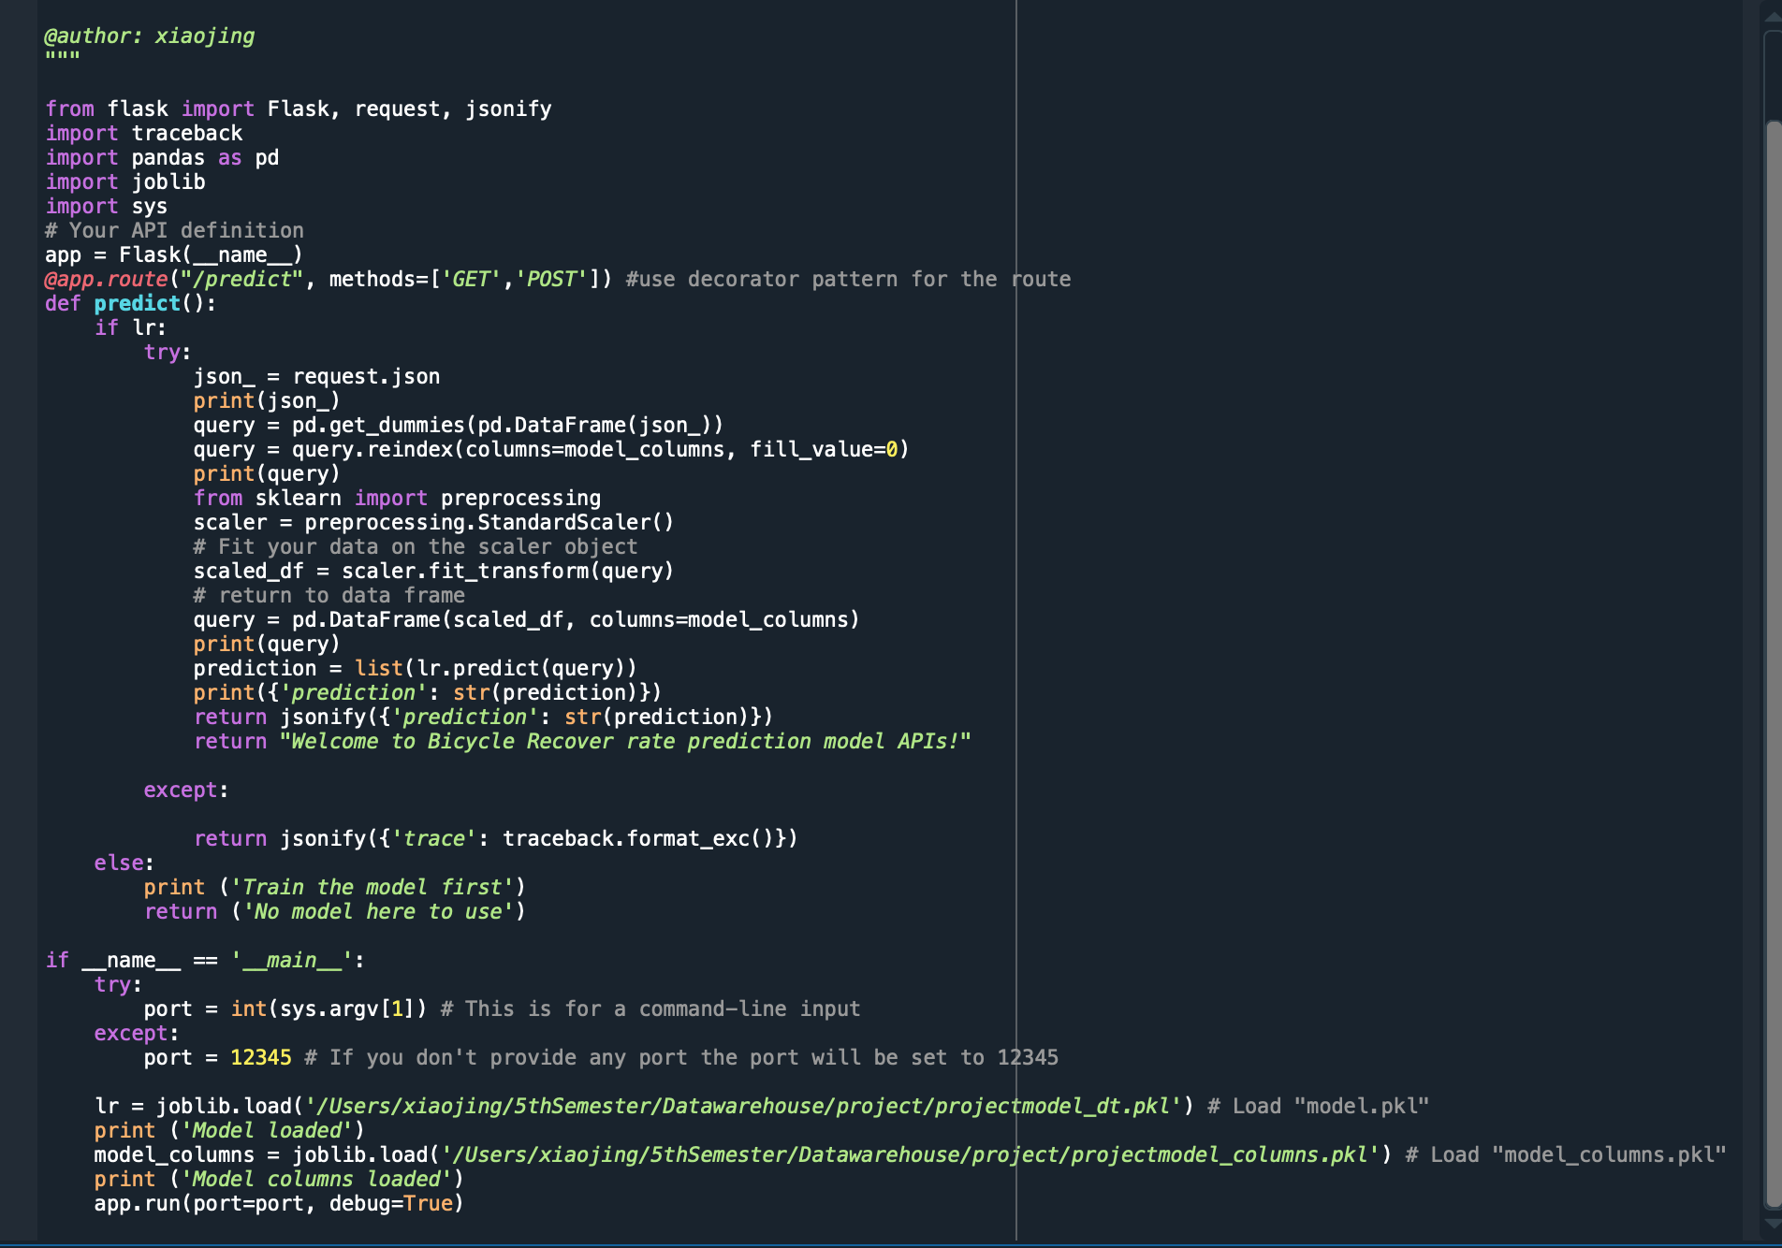
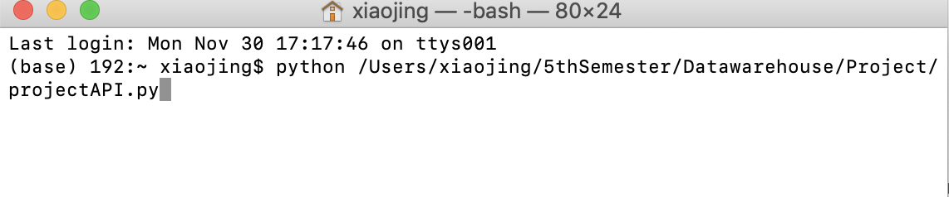
06
Deployment

Slide 25
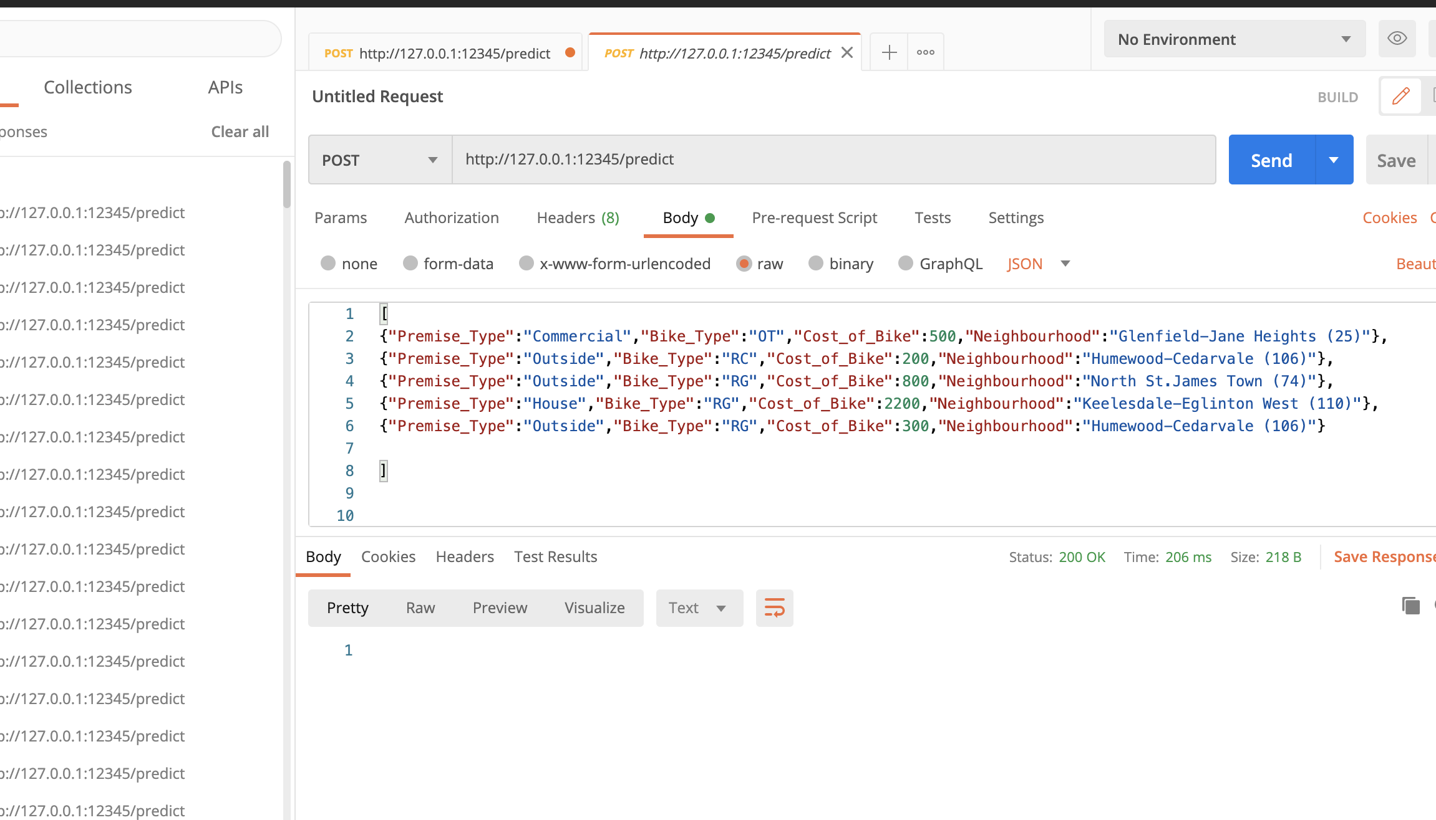
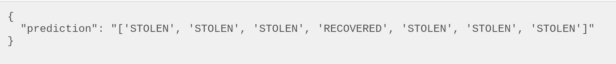
06
Deployment
Deployed using POSTMAN
Also displayed in the Console

Slide 26
Thank you for your attention!
Reference:
https://scikit-learn.org/stable/
https://pandas.pydata.org/
https://numpy.org/
http://flask.pocoo.org/
https://www.getpostman.com/automated-testing
https://www.datacamp.com/community/tutorials/machine-learning-models-api-python
https://www.analyticsvidhya.com/blog/2017/09/machine-learning-models-as-apis-using-flask/
http://data.torontopolice.on.ca/datasets/16f2b8a1c76547c69fec14b7f8541ffc_0
https://elitedatascience.com/imbalanced-classes

